Slide 1
Sources of Change in the Life-Cycle Decisions of American Men and Women: 1962-2014
Zvi Eckstein, Michael Keane and Osnat Lifshitz
March 2016
University of Pennsylvania, September 8, 2016
Notes:
Education, Marital Sorting and Labor Supply of Couples

Slide 2
Outline
Study life-cycle decisions of five cohorts of American men and women born from the 1930s to the 1970s in a unified econometric framework applied to CPS data
Data
Questions
Model
Results

Slide 3
Labor Market Data for Married, Divorced and Single
CPS Data, Caucasian 22-65: 1962-2014

Slide 4
Employment Rates
Married Female Employment Increased
Non-Married Employment Fluctuates
Married Males 86% to 64% of population
Divorced Females 3% to 13% of Population
Single Males 10% to 24% of population
Single Females
7% to 19% of population
Divorced Males 2% to 9% of population
Married Females
79% to 63% of Population
Women
Men
Caucasian, 22-65
Notes:
Stable employment rates for married females since 1997
Significant negative trend for non-married females/males since 2000
Stronger drop in recent recession 2008-11 for non-married females and males

Slide 5
Unemployment Rates
Divorced Females
Single Males
Divorced Males
Single Females
Married Females
Married Males
Caucasian, 22-65
Notes:
1. Higher unemployment rates among non-married men. Large change in recent recession
2. Married and non-married unemployment for females are the same and same as married men.
3. Non-married respond more to recent recession.
4. Divorced and single males have the same response and level of UE that is different than married males.

Slide 6
Female Employment Rates by Cohort only Married Female Employment increases by cohort
Married Female
Non-Married Female
Years 1962-2014. Proportion of women working 10+ weekly hours.
Caucasian, 22-65
Notes:
Large cohort employment rise for married females all ages: recent convergence (1965-75)
Small and similar rise in employment rates for non-married by cohort.
Can the model capture the convergence of the 65, 75 and 85 cohorts?

Slide 7
Male Employment Rates by Cohort
No Change by Cohort
Married Men
Non-Married Men
Years 1962-2014. Proportion of men working 10+ weekly hours.
Caucasian, 22-65
Notes:
Almost no change by cohorts for men – married and non-married.
Some decrease for both for 1965 men (more for non-married)

Slide 8
Annual Wages of Full-Time Workers: Married women become like men?
Women
Men
Annual Growth Rate 1980-2014:
Married 2%
Divorced 1.5%
Single 1.2%
Annual Growth Rate 1980-2014:
Married 1.1%
Divorced 0.8%
Single 0.9%
Full-time full-year workers with non-zero wages. 2006 Prices.
Caucasian, 22-65
Notes:
Since 1992 married females wages are higher than that non-married.
Single females wages stay constant since 2002 – similar to single men
Females look more like men – but trend and levels are still different

Slide 9
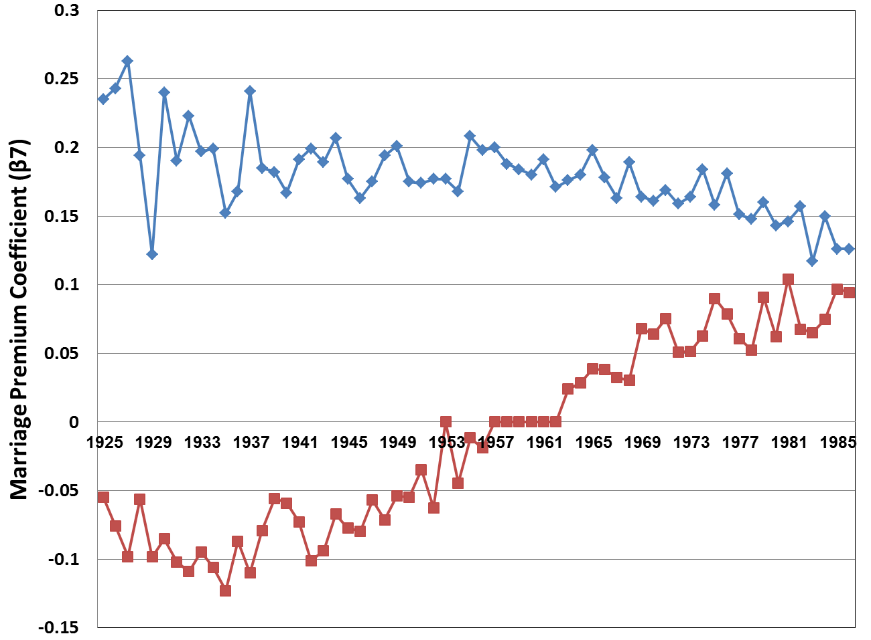
Marriage Premium by Cohort
Marriage premium for males is decreasing and for females is increasing. Selection into marriage has changed
Men
Married women look like married men?
Women
Caucasian, 22-65
Notes:
Marriage premium for males is decreasing and for women is increasing. Selection into marriage has changed. Why?

Slide 10
What do we do?
How much the differences in education, work, marriage/divorce and fertility across the five cohorts (35, 45, 55, 65, 75) are due to shifts in five factors?
Parental education –exogenous (data)
distribution of potential partners – depends on endogenous educational distribution
divorce laws (cost) – Exogenous (estimated)
the wage/job offer distribution – depends on experience and education (endogenous and estimated)
birth control technology – exogenous (estimated)

Slide 11
Literature
Chiappori (1992, 1988)
Mazzocco, M. C.Ruis and S. Yamaguchi (2007)
Keane and Wolpin (1997, 2010)
Eckstein and Lifshitz (2011)
Mulligan and Rubinstein (2006)
Fernandez and Wong (2011); Voena (2011)
Goldin and Katz (2002)
Greenwood and Seshardi (2005)
Notes:
Mulligan and Rubinstein (2005)
Blau and Kahn (2007) `Changes in the labor supply behavior of married women: 1980-2000.‘ - women's labor supply became less
responsive to their husbands' wages over time.
GREENWOOD and SESHADRI (2005): “Technological Progress and Economic Transformation,”
Fernandez and Wong (2011) `The disappearing gender gap: The impact of divorce, wages, and preferences on education choices and women's work.‘ - argue that the increase in the probability of divorce can explain a large proportion of the observed changes in female employment from the 1935 to the 1955 cohort.

Slide 12
The Model

Slide 13
Basics
Females (f) and males (m) make annual decisions from age (t) 16 to 65.
Choice variables:
  Schooling
  Employment: full time, part time, unemployment
  Married / Divorce
  Fertility

Slide 14
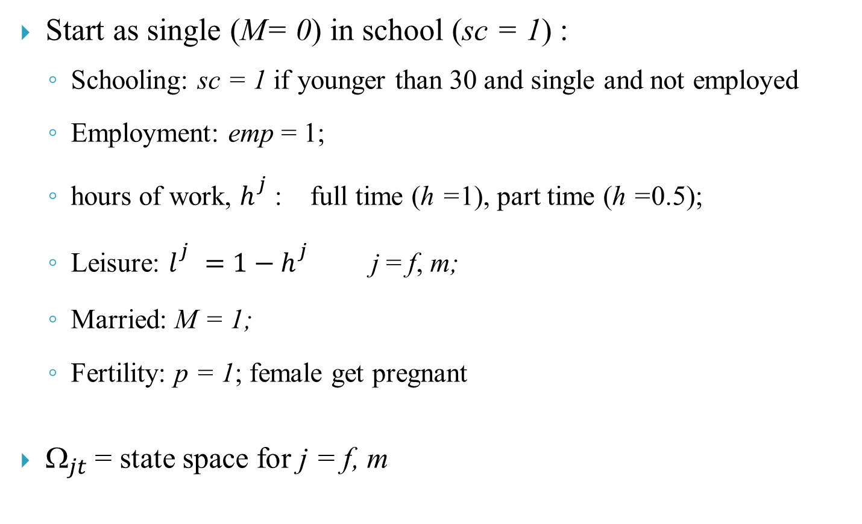
Basics (Cont.)
Start as single (M= 0) in school (sc = 1) :
  Schooling: sc = 1 if younger than 30 and single and not employed
  Employment: emp = 1;
  hours of work, $h_{}^{j}$: full time (h =1), part time (h =0.5);
  Leisure: $l_{}^{j}=1−h_{}^{j}$ j = f, m;
  Married: M = 1;
  Fertility: p = 1; female get pregnant
$_{jt}$ = state space for j = f, m

Slide 15
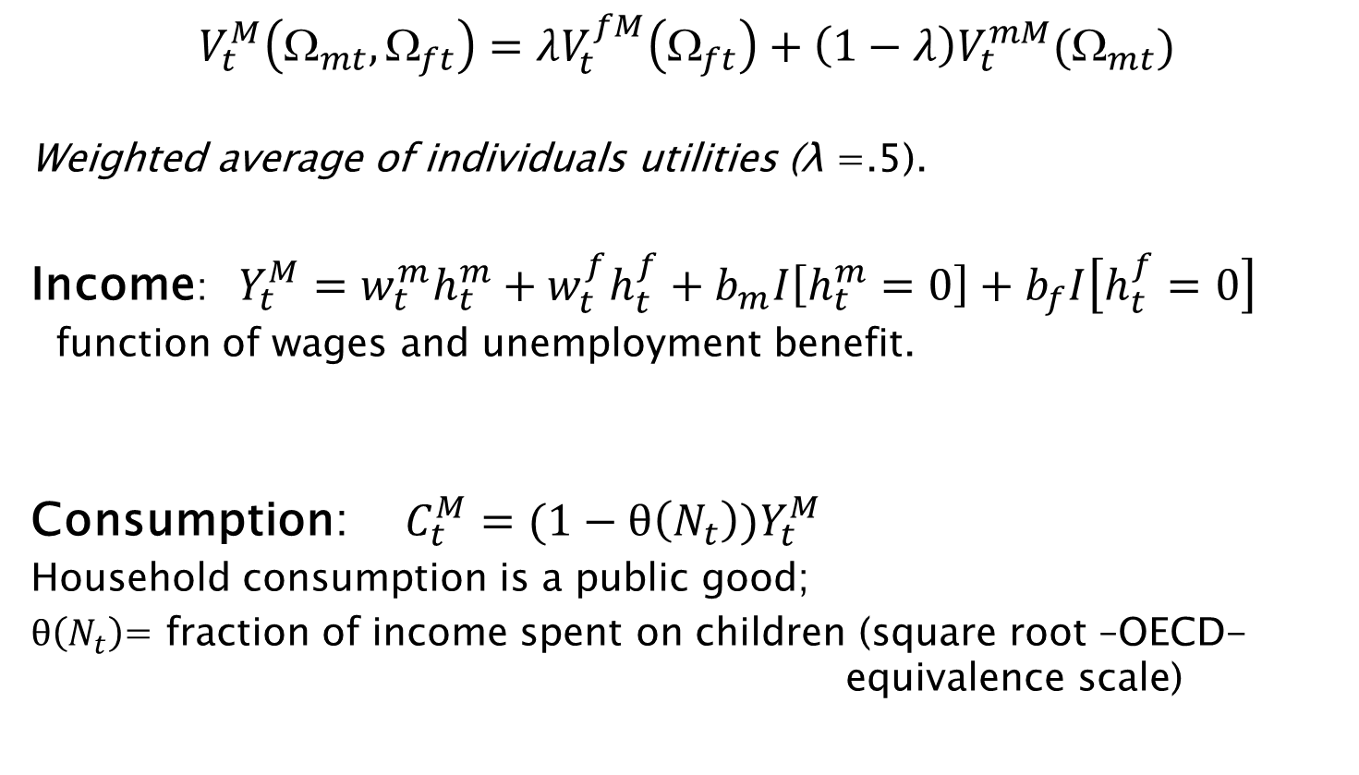
Value functions for married
$V_{t}^{M}\left(Ω_{mt},Ω_{ft}\right)=λV_{t}^{fM}\left(Ω_{ft}\right)+\left(1−λ\right)V_{t}^{mM}(Ω_{mt})$
Weighted average of individuals utilities (λ =.5).
Income:$Y_{t}^{M}=w_{t}^{m}h_{t}^{m}+w_{t}^{f}h_{t}^{f}+b_{m}I\left[h_{t}^{m}=0\right]+b_{f}I\left[h_{t}^{f}=0\right]$
function of wages and unemployment benefit.
Consumption: $C_{t}^{M}=(1−θ\left(N_{t}\right))Y_{t}^{M}$
Household consumption is a public good;
$θ\left(N_{t}\right)$= fraction of income spent on children (square root –OECD- equivalence scale)

Slide 16


Married person utility
$$V_{t}^{jM}\left(Ω_{jt}\right)=\frac{1}{α}{\left({ψC}_{t}^{M}\right)}^{α}+L{\left(l_{t}^{j}\right)}^{}+θ_{t}^{}+π_{t}^{M}p_{t}+{A_{j}^{M}}^{}Q\left(l_{t}^{f},l_{t}^{m}, Y_{t}^{M},N_{t}\right)$$
$+δEV(Ω_{j,t+1})$
$\frac{1}{α}{\left({ψC}_{t}^{M}\right)}^{α}$ - Consumption $(ψ$ =0.85)
$L{\left(l_{t}^{j}\right)}^{}$ - Leisure (depends on health, education, new born and stochastic shock )
$θ_{t}^{}$- utility from marriage (function of education and health gap and stochastic shock )
$π_{t}^{M}p_{t}$ - utility from pregnancy (function of health, number of children, previous period pregnancy and stochastic shock)
$A^{M}Q$- quality and quantity of children (function of parents’ leisure and consumption)

Slide 17


Married person utility (cont.)
$$V_{t}^{jM}\left(Ω_{jt}\right)=\frac{1}{α}{\left({ψC}_{t}^{M}\right)}^{α}+L{\left(l_{t}^{j}\right)}^{}+θ_{t}^{}+π_{t}^{M}p_{t}+{A_{j}^{M}}^{}Q\left(l_{t}^{f},l_{t}^{m}, Y_{t}^{M},N_{t}\right)$$
$+δEV(Ω_{j,t+1})$
Where
L$\left(l_{t}^{j}\right)=\frac{β_{jt}}{γ}{\left(l_{t}^{j}\right)}^{γ}+μ_{jt}l_{t}^{j}$ - Value of Leisure
β_{jt} - tastes for leisure, depends on health( ), education (E_{jt}) and pregnancy (for females)
${ln⁡(μ}_{jt})=τ_{0j}{ln⁡(μ}_{jt−1})+τ_{1j}+τ_{2j}p_{t−1}+ε_{jt}^{l}l_{t}^{j} and ε_{jt}^{l}\sim iidN(0,σ_{ε}^{l}){}$
${ μ}_{jt}$- marginal utility of leisure that increases with a new born and then slowly converge to the steady state value of $τ_{1j}$ (ar(1)).

Slide 18
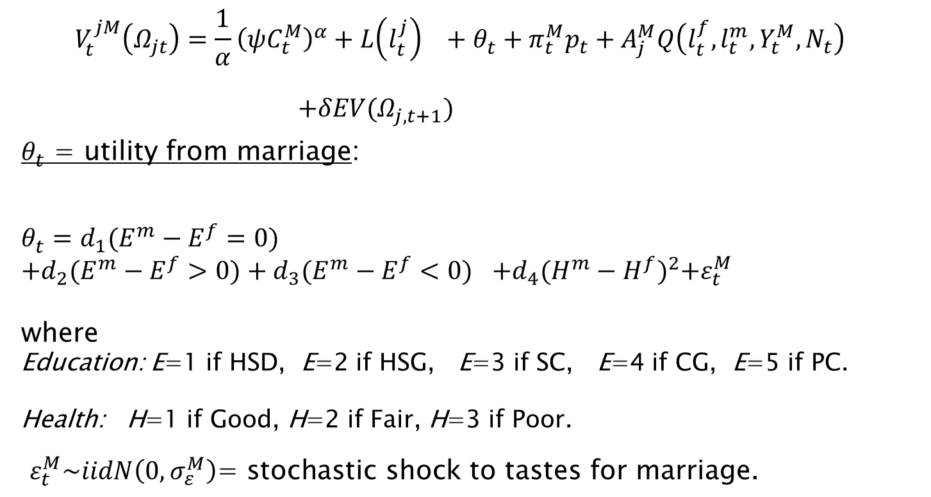
Married person utility (cont.)
$$V_{t}^{jM}\left(Ω_{jt}\right)=\frac{1}{α}{\left({ψC}_{t}^{M}\right)}^{α}+L{\left(l_{t}^{j}\right)}^{}+θ_{t}^{}+π_{t}^{M}p_{t}+A_{j}^{M}Q\left(l_{t}^{f},l_{t}^{m}, Y_{t}^{M},N_{t}\right)$$
$+δEV(Ω_{j,t+1})$
$θ_{t}^{}$ = utility from marriage:
$$θ_{t}^{}=d_{1}{(E^{m}−E^{f}=0)}^{}$$
$$+d_{2}(E^{m}−E^{f}>0)+d_{3}{(E^{m}−E^{f}<0)}^{}+d_{4}{(H^{m}−H^{f})}^{2}+ε_{t}^{M}$$
where
Education: E=1 if HSD, E=2 if HSG, E=3 if SC, E=4 if CG, E=5 if PC.
Health: H=1 if Good, H=2 if Fair, H=3 if Poor.
$ε_{t}^{M}\sim iidN\left(0,σ_{ε}^{M}\right)\text{= }\text{stochastic} \text{shock} \text{to} \text{tastes} \text{for} \text{marriage}\text{. }$

Slide 19
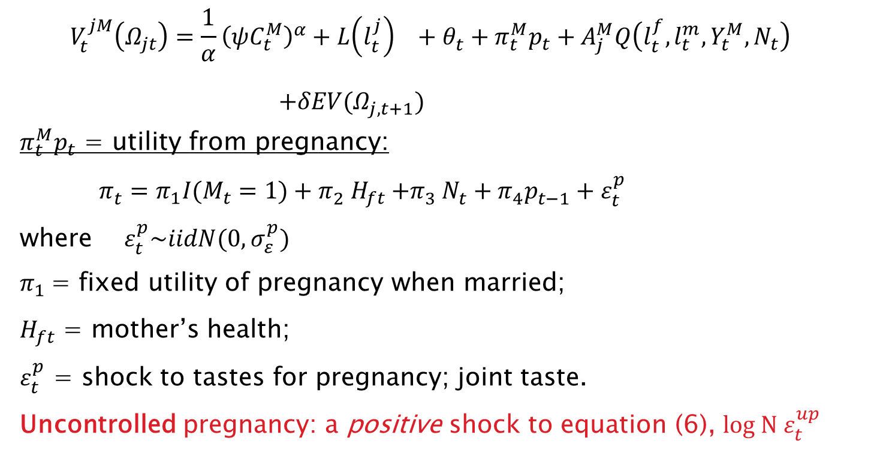
Married person utility (cont.)
$$V_{t}^{jM}\left(Ω_{jt}\right)=\frac{1}{α}{\left({ψC}_{t}^{M}\right)}^{α}+L{\left(l_{t}^{j}\right)}^{}+θ_{t}^{}+π_{t}^{M}p_{t}+A_{j}^{M}Q\left(l_{t}^{f},l_{t}^{m}, Y_{t}^{M},N_{t}\right)$$
$+δEV(Ω_{j,t+1})$
$π_{t}^{M}p_{t}$ = utility from pregnancy:
$π_{t}^{}=π_{1}I(M_{t}=1)+π_{2}^{} H_{ft}{+π}_{3}^{}N_{t}^{}+π_{4}^{}p_{t−1}^{}+ε_{t}^{p}$
where $ε_{t}^{p}\sim iidN(0,σ_{ε}^{p})$
$π_{1}$= fixed utility of pregnancy when married;
$H_{ft}$ = mother’s health;
$ε_{t}^{p}$ = shock to tastes for pregnancy; joint taste.
Uncontrolled pregnancy: a positive shock to equation (6), $log N ε_{t}^{up}$

Slide 20
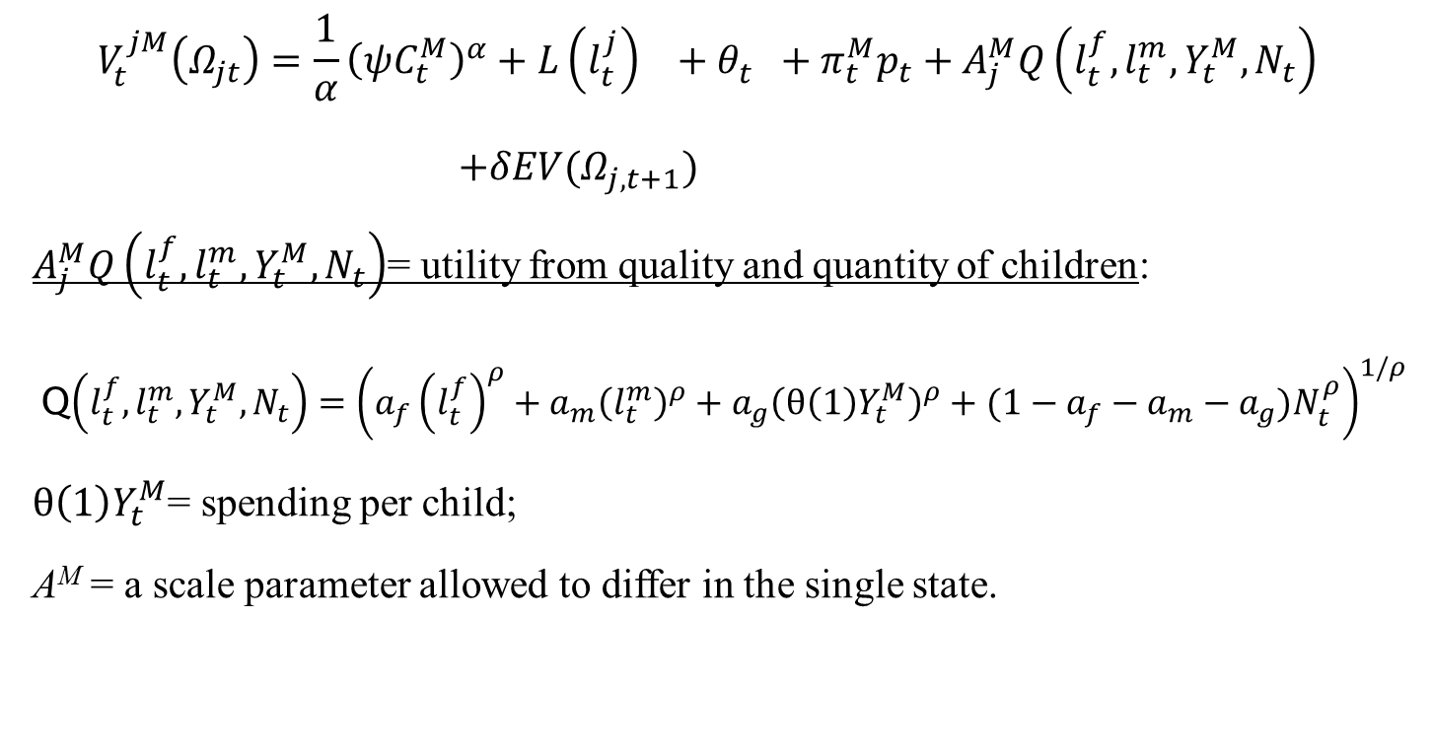
Married person utility (cont.)
$$V_{t}^{jM}\left(Ω_{jt}\right)=\frac{1}{α}{\left({ψC}_{t}^{M}\right)}^{α}+L{\left(l_{t}^{j}\right)}^{}+θ_{t}^{}+π_{t}^{M}p_{t}+A_{j}^{M}Q\left(l_{t}^{f},l_{t}^{m}, Y_{t}^{M},N_{t}\right)$$
$+δEV(Ω_{j,t+1})$
$A_{j}^{M}Q\left(l_{t}^{f},l_{t}^{m}, Y_{t}^{M},N_{t}\right)$= utility from quality and quantity of children:
Q$\left(l_{t}^{f},l_{t}^{m}, Y_{t}^{M},N_{t}\right)={\left(a_{f}{\left(l_{t}^{f}\right)}^{ρ}+a_{m}{\left(l_{t}^{m}\right)}^{ρ}+a_{g}{\left(θ\left(1\right)Y_{t}^{M}\right)}^{ρ}+(1−a_{f}−a_{m}−a_{g})N_{t}^{ρ}\right)}^{1/ρ}$
$θ\left(1\right)Y_{t}^{M}$= spending per child;
A^{M} = a scale parameter allowed to differ in the single state.

Slide 21
Health process
The health transition probability is a multinomial Logit function:

Slide 22
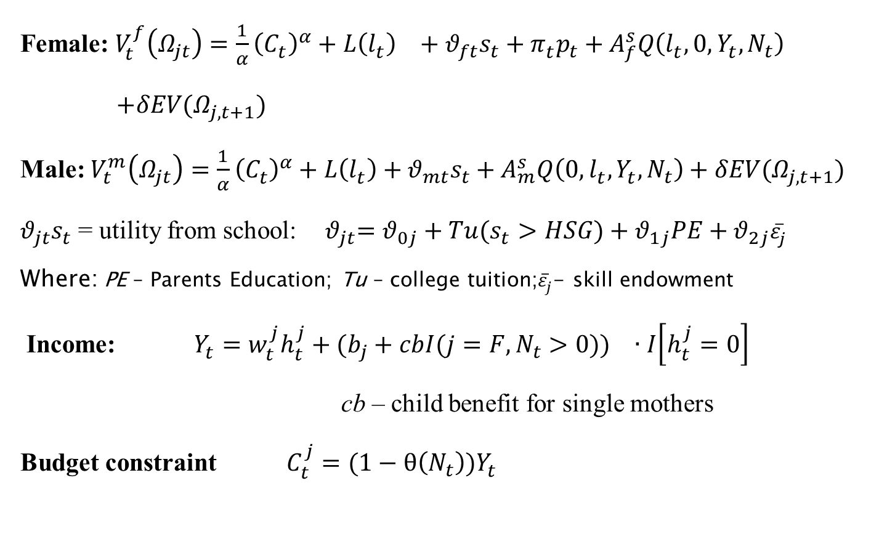
Value functions for singles
Female: $V_{t}^{f}\left(Ω_{jt}\right)=\frac{1}{α}{\left(C_{t}^{}\right)}^{α}+L{\left(l_{t}^{}\right)}^{}+{θ_{ft}s}_{t}+π_{t}^{}p_{t}+A_{f}^{s}Q\left(l_{t}^{},0, Y_{t}^{},N_{t}\right)$
$+δEV(Ω_{j,t+1})$
Male: $V_{t}^{m}\left(Ω_{jt}\right)=\frac{1}{α}{\left(C_{t}^{}\right)}^{α}+L\left(l_{t}^{}\right)+{θ_{mt}s}_{t}+A_{m}^{s}Q\left(0,l_{t}^{}, Y_{t}^{},N_{t}\right)+δEV(Ω_{j,t+1})$
${θ_{jt}s}_{t}$ = utility from school: ${ θ}_{jt}=θ_{0j}+Tu(s_{t}>HSG)+θ_{1j}PE+θ_{2j}{\overline{ε}}_{j}^{}$
Where: PE – Parents Education; Tu – college tuition;${\overline{ε}}_{j}^{}$- skill endowment
Income: $Y_{t}^{}=w_{t}^{j}h_{t}^{j}+({b_{j}+cbI({j=F,N}_{t}>0))}_{}∙I\left[h_{t}^{j}=0\right]$
cb – child benefit for single mothers
Budget constraint $C_{t}^{j}=(1−θ\left(N_{t}\right))Y_{t}^{}$
Notes:
More skilled people (epsilon bar) get more utility from school. Note: epsilon bar is the fixed effect in the wage equation, and it depends on mother education. We don’t need any taste shocks because we are not fitting individual data.

Slide 23
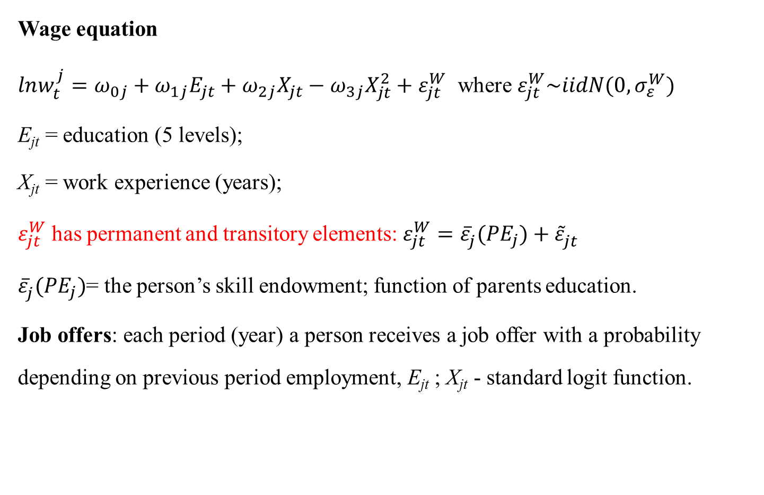
Labor market
Wage equation
$lnw_{t}^{j}=ω_{0j}+ω_{1j}E_{jt}+ω_{2j}X_{jt}−ω_{3j}X_{jt}^{2}+ε_{jt}^{W}$ where $ε_{jt}^{W}\sim iidN(0,σ_{ε}^{W})$
E_{jt} = education (5 levels);
X_{jt} = work experience (years);
$ε_{jt}^{W}$ has permanent and transitory elements: $ε_{jt}^{W}={\overline{ε}}_{j}^{}({PE}_{j})+{\tilde{ε}}_{jt}^{}$
${\overline{ε}}_{j}^{}({PE}_{j})$= the person’s skill endowment; function of parents education.
Job offers: each period (year) a person receives a job offer with a probability depending on previous period employment, E_{jt} ; X_{jt} - standard logit function.
Notes:
We can identify both how PE effects epsilon_bar and how PE affects utility school directly (in addition to through epsilon_bar) because we see both school choices and wage data

Slide 24
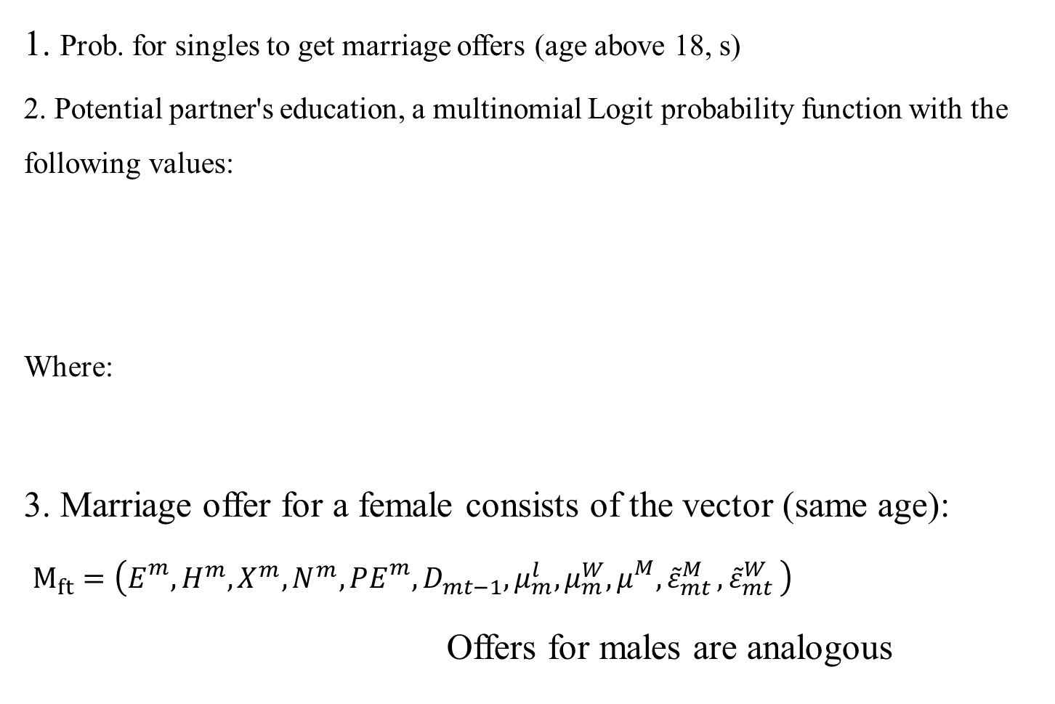
Marriage market
1. Prob. for singles to get marriage offers (age above 18, s)
2. Potential partner's education, a multinomial Logit probability function with the following values:
Where:
3. Marriage offer for a female consists of the vector (same age):
$M_{ft}=\left(E_{}^{m},H^{m},X^{m},N^{m},PE_{}^{m},D_{mt−1},μ_{m}^{l}, μ_{m}^{W},μ_{}^{M}{, \tilde{ε}}_{mt}^{M}{, \tilde{ε}}_{mt}^{W}\right)$
Offers for males are analogous

Slide 25
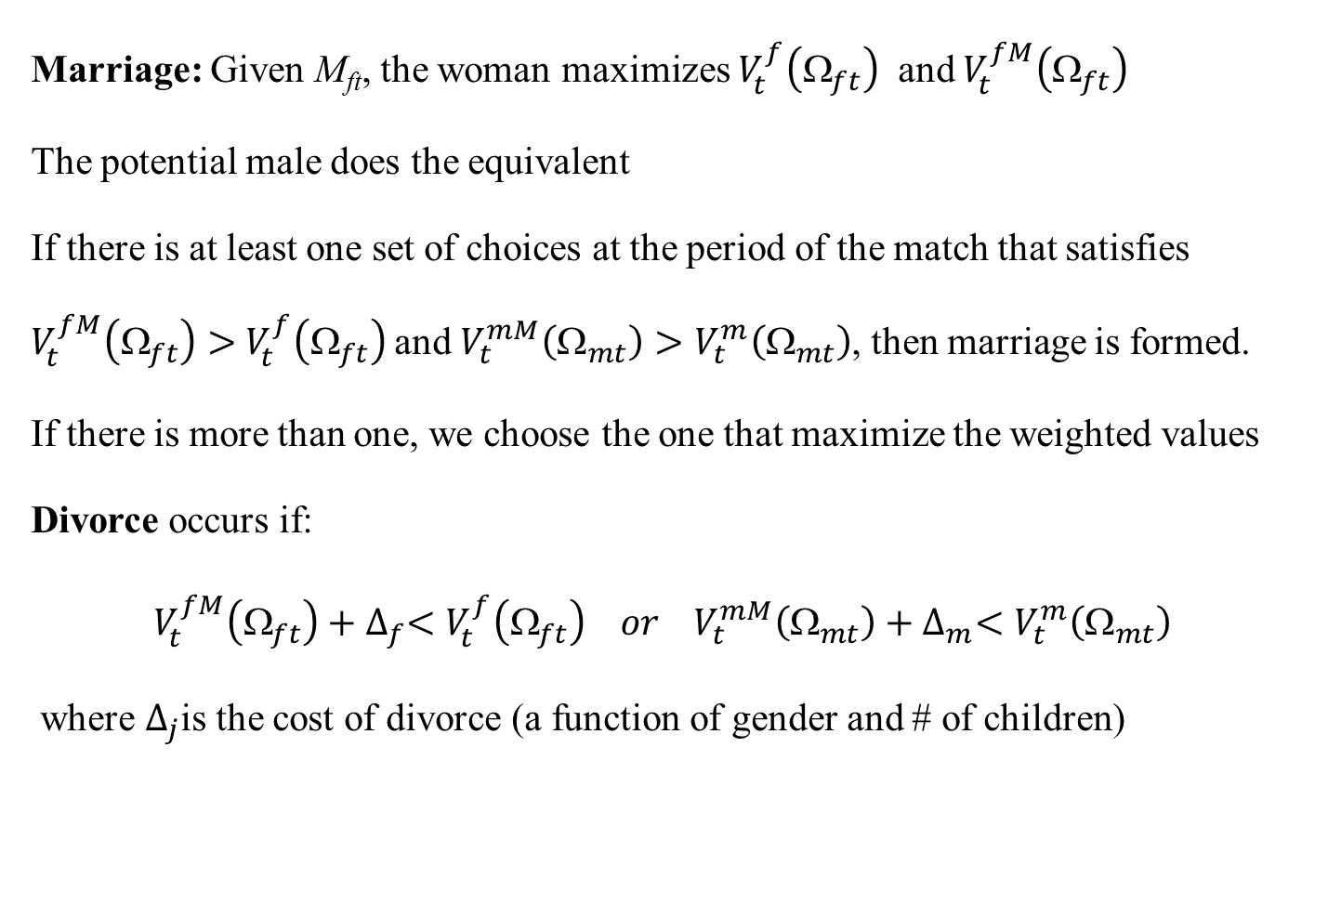
Marriage decision problem
Marriage: Given M_{ft}, the woman maximizes $V_{t}^{f}\left(Ω_{ft}\right)$ and $V_{t}^{fM}\left(Ω_{ft}\right)$
The potential male does the equivalent
If there is at least one set of choices at the period of the match that satisfies $V_{t}^{fM}\left(Ω_{ft}\right)>$ $V_{t}^{f}\left(Ω_{ft}\right)$and $V_{t}^{mM}\left(Ω_{mt}\right)>V_{t}^{m}\left(Ω_{mt}\right)$, then marriage is formed.
If there is more than one, we choose the one that maximize the weighted values
Divorce occurs if:
$V_{t}^{fM}\left(Ω_{ft}\right)+∆_{f}<V_{t}^{f}\left(Ω_{ft}\right) or V_{t}^{mM}\left(Ω_{mt}\right)+∆_{m}<V_{t}^{m}\left(Ω_{mt}\right)$
where $∆_{j}$is the cost of divorce (a function of gender and # of children)

Slide 26
Estimation
DP problem is solved recursively
Estimate by simulated GMM.
CPS data (moments) of the cohorts of: 1945 (1943-1947); 55; 65
Untargeted Cohorts: 1935; 1975
Keep all preferences parameters as estimated in stage 1 for 1945, 55, 65 cohorts
Estimate exogenous process for each cohort separately

Slide 27
Moments
moment | # of moments 1945 | # of moments 1955 | # of moments 1965
Married Women Employment | 40* | 40* | 30**
Unmarried Women Employment | 40* | 40* | 30**
Married Men Employment | 40* | 40* | 30**
Unmarried Men Employment | 40* | 40* | 30**
Married Women Full Time | 40* | 40* | 30**
Unmarried Women Full Time | 40* | 40* | 30**
Married Men Full Time | 40* | 40* | 30**
Unmarried Men Full Time | 40* | 40* | 30**
Married with Children Women Employment | 40* | 40* | 30**
Married no Children Women Employment | 40* | 40* | 30**
Unmarried with Children Women Employment | 40* | 40* | 30**
Unmarried no Children Women Employment | 40* | 40* | 30**
Men Schooling Distribution – 5 groups | 5 X 14*** | 5 X 14*** | 5 X 14***
Women Schooling Distribution – 5 groups | 5 X 14*** | 5 X 14*** | 5 X 14***
Marriage Rate | 40* | 40* | 30**
Divorce Rate | 40* | 40* | 30**
Women # of Children by Age | 24**** | 24**** | 24****
Married Women # of Children by Age | 24**** | 24**** | 24****
Women Wage | 30** | 30** | 30**
Married Women Wage | 30** | 30** | 30**
Unmarried Women Wage | 30** | 30** | 30**
Men Wage | 30** | 30** | 30**
Assortative Mating | 5 X 5 | 5 X 5 | 5 X 5
Wage by education level – women only | 5 X 30** | 5 X 30** | 5 X 30**
Employment by education level – women only | 5 X 40* | 5 X 40* | 5 X 30**
Women Health distribution | 3 X 44***** | 3 X 44***** | 3 X 44*****
Men Health distribution | 3 X 44***** | 3 X 44***** | 3 X 44*****
152 Parameters (stage 1)
1505 moments for 1945 1505 moments for 1955 1185 moments for 1965
1241 moments for 1935 865 moments for 1975
Notes:
*most moment starts at age 16 and end at 58, 43 periods (the 1955 cohort is 58 years old today)
** Schooling distribution from age 16 to 30, no schooling after 30.
*** from age 16 to 40. No newborn after 40.
**** 116 parameters in dynamic model (for one cohort), 84 in static model (the difference is the terminal value parameters)

Slide 28
Assessing the Impact of Exogenous Factors on Life-Cycle Decisions

Slide 29
The Impact of Exogenous Factors
Stage 1: Benchmark Model: mother’s education and health transition process. mother’s education affects: tastes for school and ability type (35:6%, 45:6%, 55:11%, 65:20%, 75:27%)
Stage 2: Matching Function: parameters of the marriage market matching function change (estimate) by cohort.
Stage 3: Divorce Costs: change by cohort
Stage 4: Labor Market: wage offer function and the job offer probabilities.
Stage 5: Birth Control Technology.
Utility and preferences parameters are identical between cohorts and stages

Slide 30
Stage 1: Benchmark Model
(mother’s education differ by cohort)
We fit the education distribution of 1945, 1955, 1965. we don’t fit 1935, 1975.
We fit marriage rate, divorce rate and number of children of all cohorts but 1935
We don’t fit the wage and employment of 1935, 1945 (overestimate) and 1965, 1975 (underestimate)
Men Education Distribution
Women Education Distribution

Slide 31
Stage 2/3: Divorce Costs and Marriage Market
We fit the marriage and divorce moments for all cohorts
we underestimate the number of children for the 1935, 1945 cohorts
We don’t fit the wage and employment of 1935, 1945 (overestimate) and 1965, 1975 (underestimate)

Slide 32
Stage 4: Labor Market
(wage parameters and job offer probabilities)
Convergence in men and women return to education
Return to experience is higher for men even in younger cohorts

Slide 33
Stage 4: Labor Market
(wage parameters and the job offer probabilities)
Married Women Employment Rate
Married Men Employment Rate
  We fit almost all the wage and employment moments of the 5 cohorts
  We don’t fit employment rate of young women (25-34) for the 1935 and 1945.
  We don’t fit the number of children of this group (young women, 1935 and 1945)
What is the solution for more children and less employment at younger age for women of 35 and 45?

Slide 34
Stage 5: Birth Control Technology
(positive shocks for utility from pregnancy for early cohorts)
  cost of household production (Greenwood et. al., 2012): increasing the cost of children for the early cohorts gap in employment closed but the number of children unchanged .
  Use of contraception (Goldin and Katz, 2002): generating unplanned pregnancies for early cohorts (add a positive shock to the utility from pregnancy) gap in employment and number of children closed

Slide 35
The Impact of Exogenous Factors:
Mother’s Education
Only mother’s education is different between cohorts: 1935:6% college graduate moms
1975:27% college graduate moms
mother’s education affects: tastes for school and ability type Accounts for:
40% of the increase in college graduate women
60% of the decrease in marriage rate
20% of the increase in women’s wages

Slide 36
The Impact of Exogenous Factors: Divorce cost
Divorce Rate:
1935: 3% at ages 25-34, 7% at ages 35-44
1975: 7% at ages 25-34, 12% at ages 35-44
Change by cohort – estimated higher costs for the 1935, 1945 cohorts
Accounts for:
30% of the increase in college graduate women
85% of the increase in divorce rate

Slide 37
The Impact of Exogenous Factors: Labor market
wage offer function and the job offer probabilities estimated separately for each cohort.
Accounts for:
20% of the increase in college graduate women
Most of the delay in fertility
80% of the increase in women’s wages
80% of the increase in women’s employment

Slide 38
The Impact of Exogenous Factors:
Birth Control Technology
1935 cohort and 1945 cohorts have higher mean of the positive shock in the utility from pregnancy function represent unexpected pregnancies
Lower mean for the cohort of 1945 cohort
Accounts for:
10% of the increase in divorce rate
All the decrease in fertility for unmarried and most of it for married.
20% of the increase in women’s employment (mostly in early ages)

Slide 39
Marriage Premium
Untargeted
moment
1975
Actual: +6.8%
Fitted: +4.7%
1935
Actual: -10.4%
Fitted: -8.4%
17% change from 1935 to 1975
changes in the selection of women into marriage explain 75% of this change.
Married women of recent cohorts have much higher observed and unobserved skills compared both to unmarried women and the married women of past cohorts.

Slide 40
Men Marriage Premium
Data
Simulated (Stage 5)
Control for Experience
Control for Ability
50% of the marriage premium is explained by the fact that married men work more
50% is explained by selection into marriage of men with higher unobserved ability
Notes:
Run this regression on the simulated data, one with age and one with actual experience.
Run these same sorts of regression on Men too. The male marriage premium is selection. But as women work more over time, they become less concerned with skill level of the men. And men should become more concerned with the skill type of women.
We can also include a person’s skill type in the regressions on simulated data.

Slide 41
Women Marriage Premium
Data
Stage 5
Stage 1
Stage 3
17% change from 1935 to 1975: Experience and Ability do the same as for men
  30% due to education – stage 1
  43% due to the change in wage and job offers – stage 4
  23% unexplained
Notes:
Run this regression on the simulated data, one with age and one with actual experience.
Run these same sorts of regression on Men too. The male marriage premium is selection. But as women work more over time, they become less concerned with skill level of the men. And men should become more concerned with the skill type of women.
We can also include a person’s skill type in the regressions on simulated data.

Slide 42
Summary and Conclusions
We succeed in explaining differences across cohorts in
education work marriage divorce fertility
All five factors have significant contribution:
Parental education
distribution of potential partners
divorce laws (cost)
the wage/job offer distribution
birth control technology
The family formation and unit of decision is essential for understanding labor supply, education and fertility decisions.

Slide 43
Potential Extensions
Improvements in home production technology may affect earlier cohorts (before 1935) employment and wages
Forecast macro changes in the socio-demographic structure into the future cohorts
How important is assortative mating for household inequality?
How do we account for the changes in education, marriage, employment and fertility among Blacks and Hispanics?

Slide 44
Thanks

